Slide 1
Audio
Event
Classification:
Urbansound
Computer Music Language and Systems - Homework 1
Politecnico di Milano a.a. 2020/2021
E. Castelli - E. Intagliata - A. Rizzitiello - G. Zanocco

Slide 2

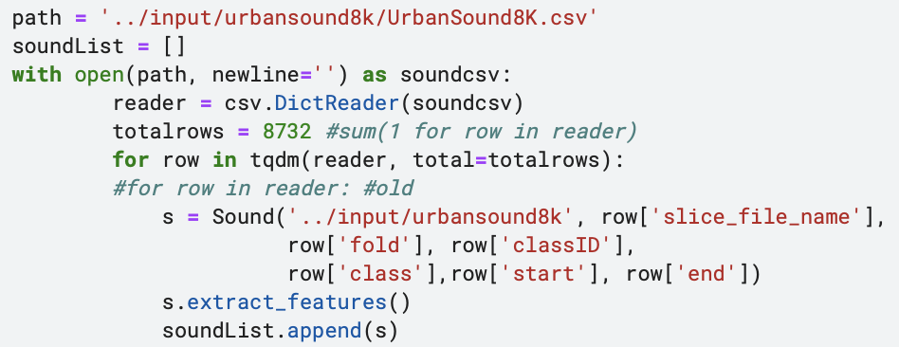
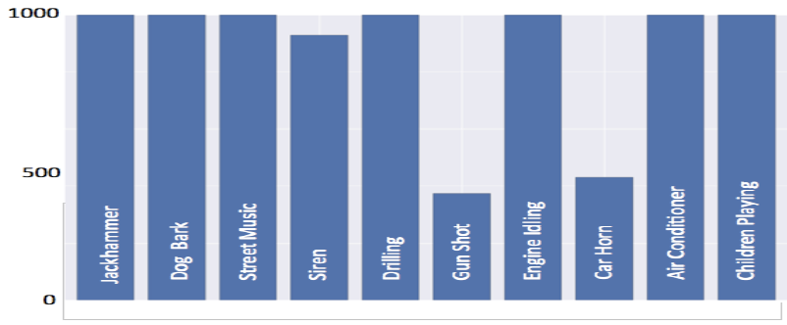

DATASET
DATASET
UrbanSound8k.csv
Sound objects
slice_file_name
fsID
start
end
salience
fold
classID
class
Air conditioner
Car horn
Children playing
Dog bark
Drilling
Engine idling
Gun shot
Jackhammer
Siren
Street music

Slide 3
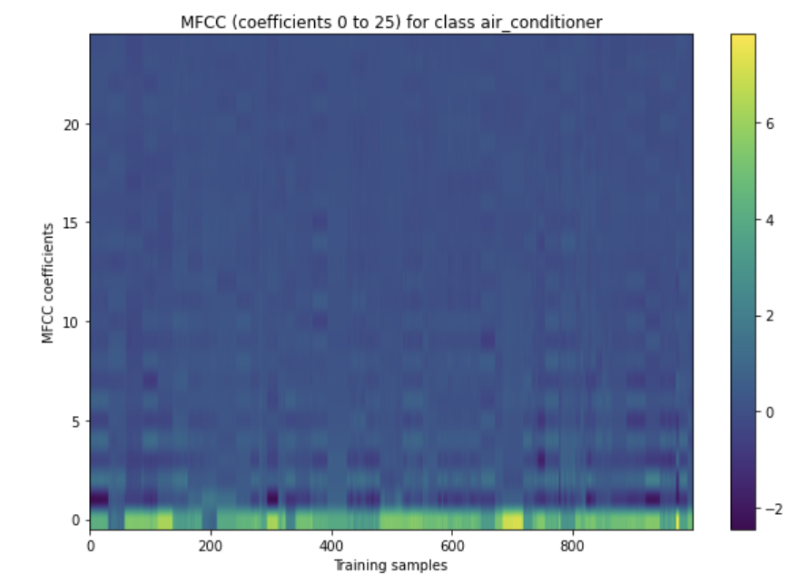
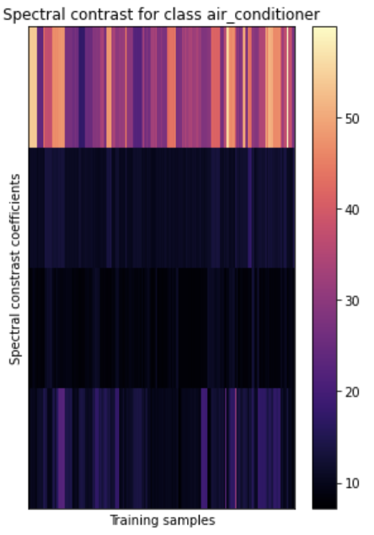
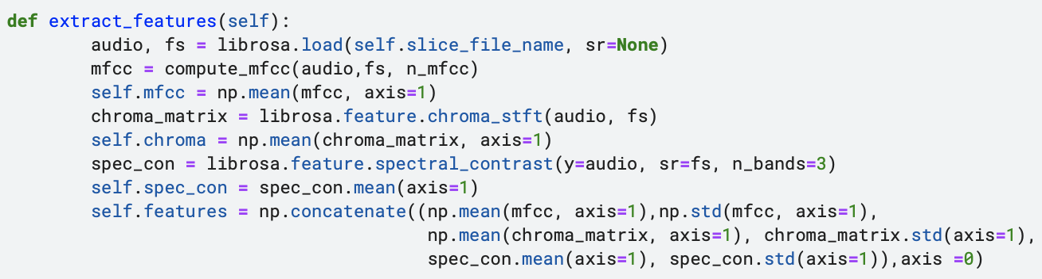
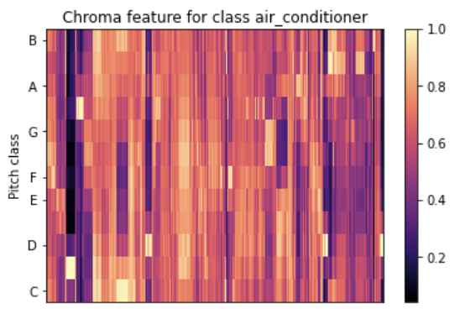
FEATURE EXTRACTION
Feature vector:
MFCC mean and standard deviation
Chroma mean and standard deviation
Spectral contrast mean and standard deviation

Slide 4
CLASSIFICATION
- Training and test steps with 10-fold cross validation
- Multiple class classifier with Support Vector Machine

Slide 5
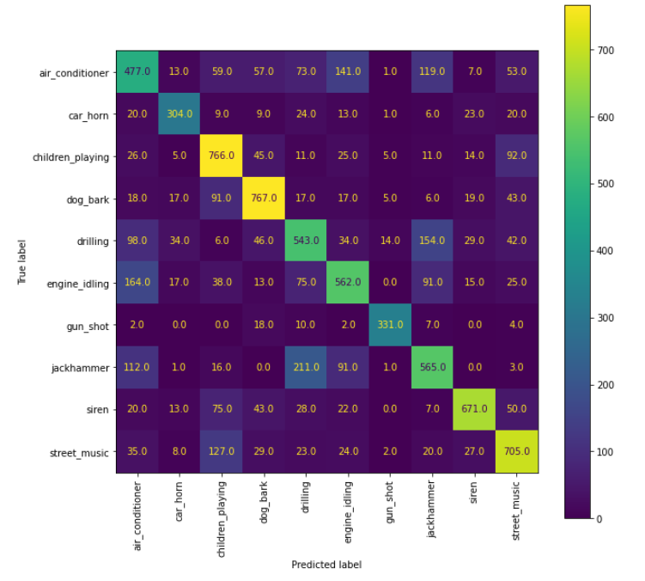

RESULTS
Classification accuracy
Confusion matrix
65,2% on average

